Slide 1
DSC640 Project Part5-ASumbaraju
File created on: 8/7/2021 4:28:51 PM

Slide 2
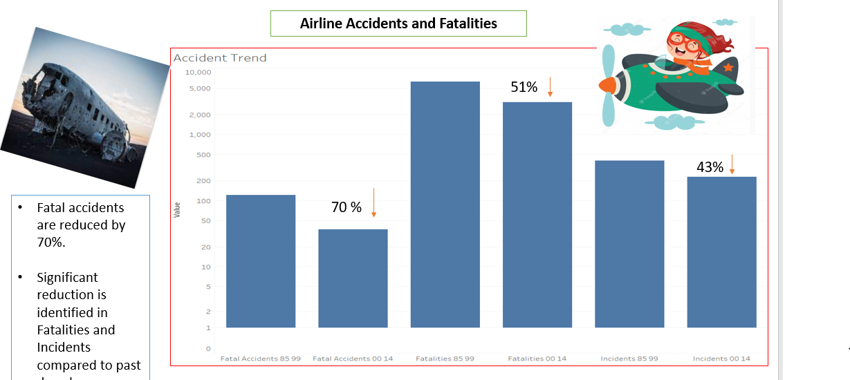
Accident Trend

Slide 3
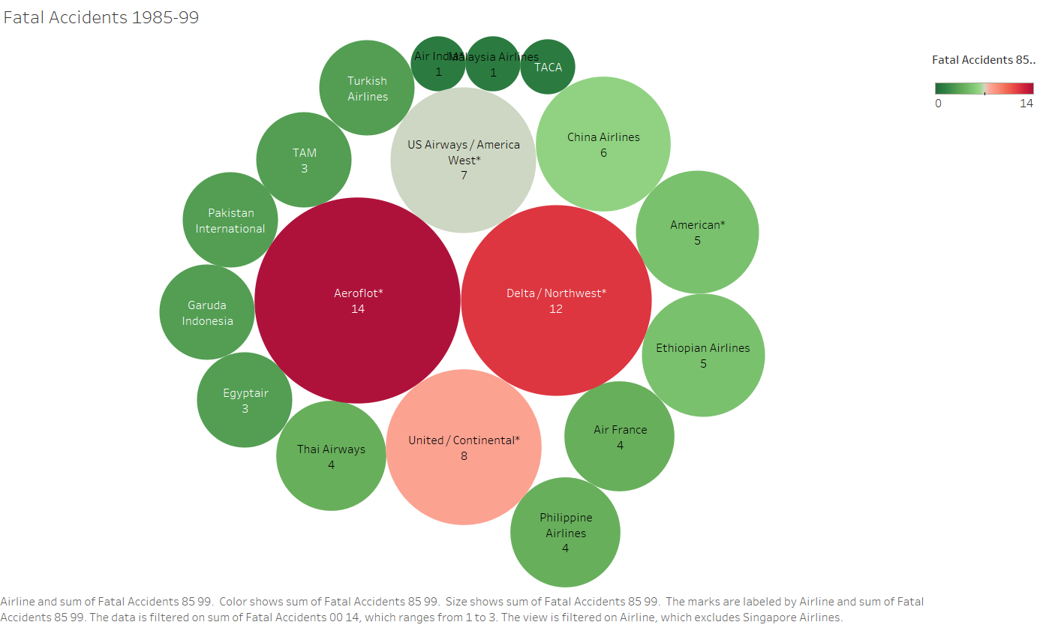
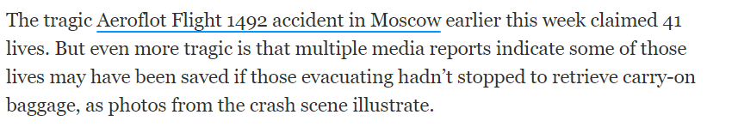
Aeroflot contributes 14 fatalities in period 1985-99. Hence considered as bad Airline performer. American and Air India are considered as good Performer in terms of Passenger safety.

Slide 4
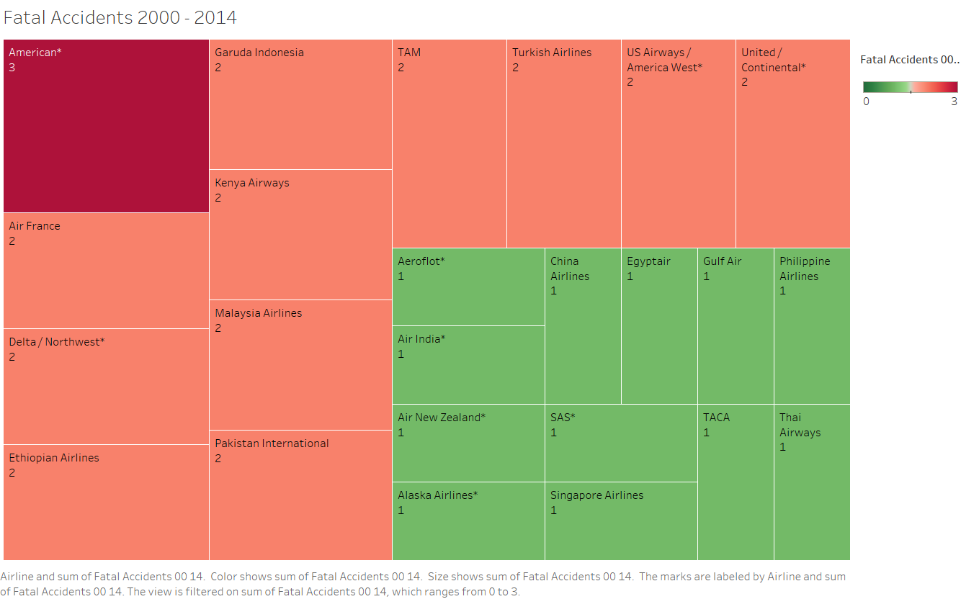

Slide 5
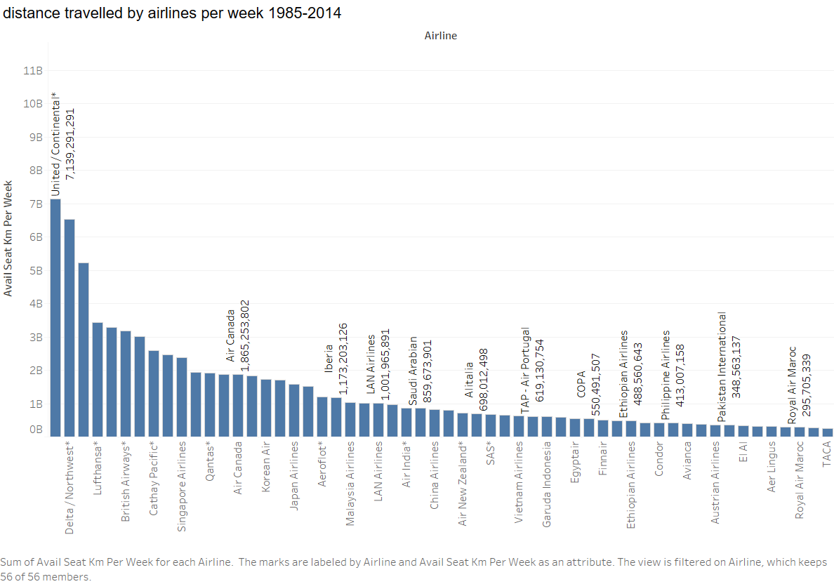

Slide 6
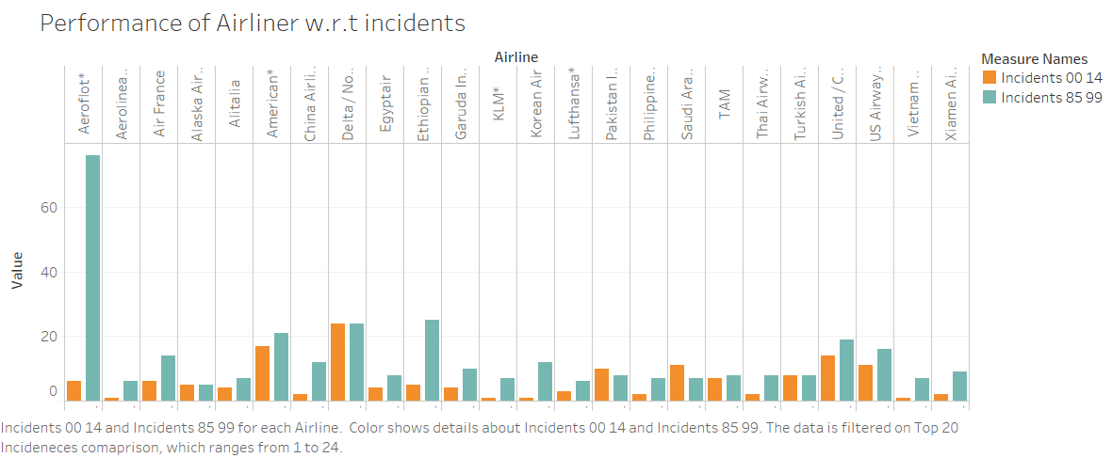

Slide 7
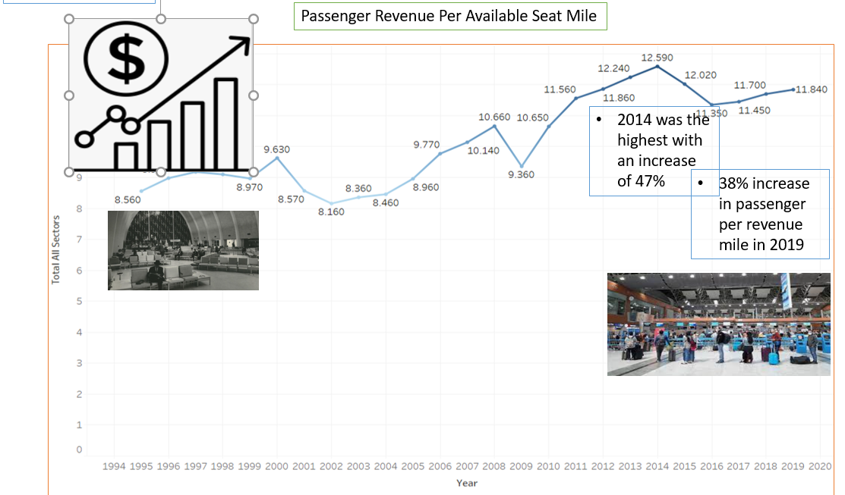

Slide 8
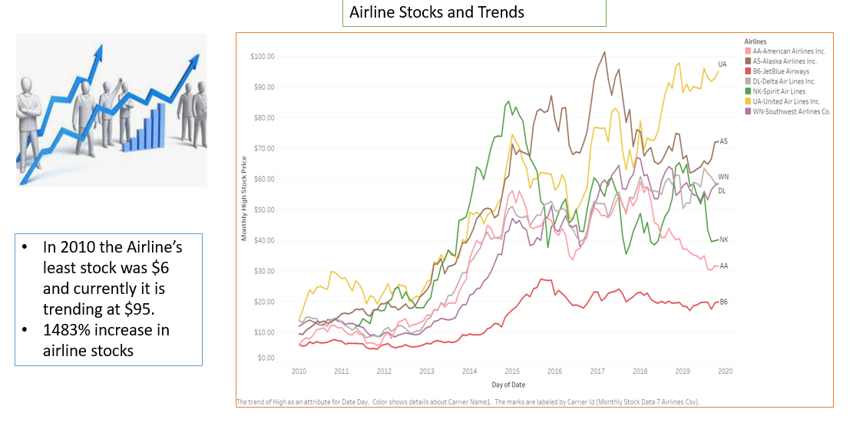

Slide 9
